Slide 1
Max Weber
17 March 2020
GENTRAIN
MONTEREY PENINSULA COLLEGE
STEPHANIE SPOTO

Slide 2
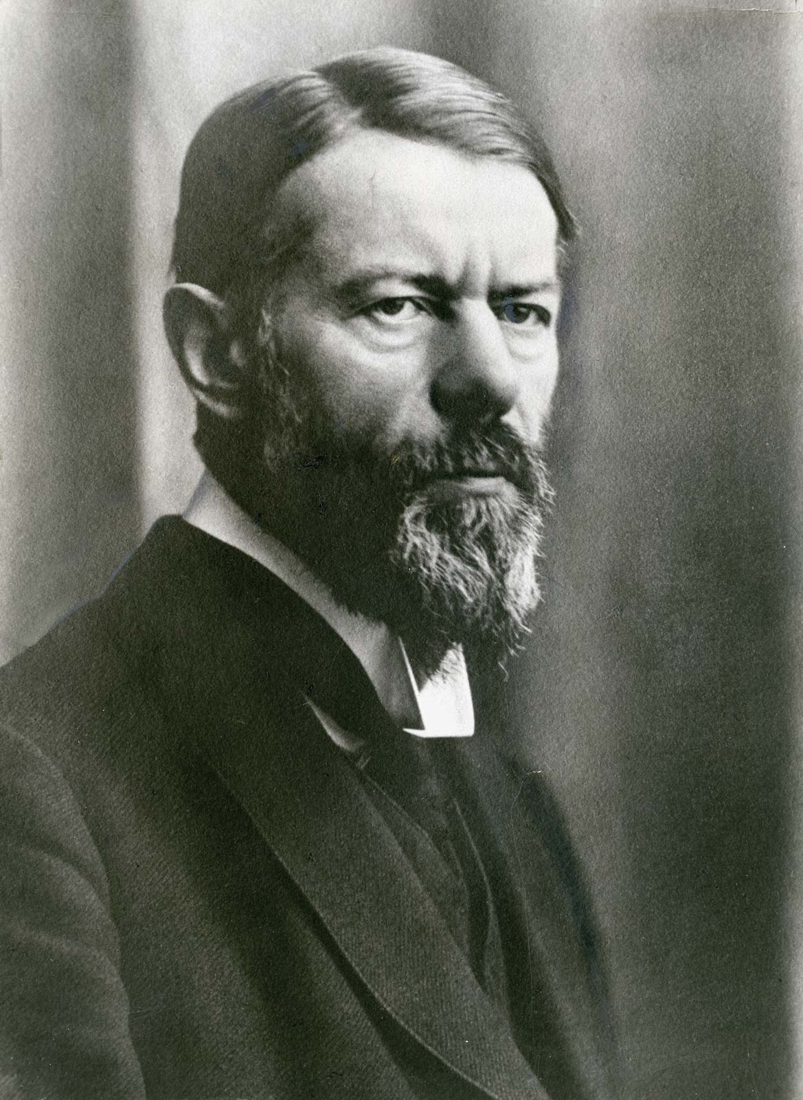
Max Weber (1864-1920)
Born in Prussia (in Erfurt) to a family of nobility and power
Studied law at Berlin and Heidelberg universities
Worked in the field of law and public service, but received a commission to study the displacement of German agrarian workers by Polish migrant laborers.
  This report won him a professorship and intellectual acclaim. The group of people who formed themselves around him was known as the “Weber Circle”
His most important work is The Protestant Ethic and the Spirit of Capitalism (1904-1905)
Considered one of the fathers of social science, along with Marx and Durkheim. (For more information on these three theorists and their contributions, see the link in the resources page)

Slide 3
Weber’s philosophical influences
Primarily known as a social scientist, which attempts to take the scientific principles developed during the Enlightenment and apply them to the study of human society and relationships.
However, his thought is deeply embedded in the philosophical tradition, and many critical philosophers turn to him for philosophical insight into political and social problems.
His philosophy is informed by the sever crisis of the Enlightenment project which is one of the defining intellectual features of the modern age. This is characterized by:
  Intellectual rebellion again positivist reason: the idea that positive/certain knowledge is available through sensory experience and interpreted through logic (a central feature of Enlightenment epistemology)
  A celebration and acclaim of collective intuition and will
  A desire to spiritual wholesomeness inspired by Neo-Romanticism → rather than a focus on realism that characterized the period following German unification in 1871, the response (Neo-Romanticism) calls for a social reorientation which seeks out “the soul’s longing for meaning and content in life” (Kohlenback 2009, p. 261).

Slide 4
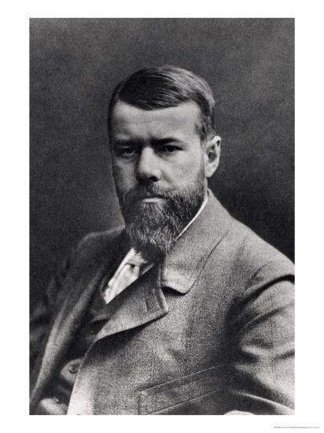
Weber’s Epistemology
Neo-Kantianism
Different varieties of Neo-Kantianism during this period, but Weber was informed by the Southwest School (also known as the Heidelberg school or the Baden School)
  Whereas the Marburg School emphasized philosophical logic, the Southwest School emphasized concerns and issues around values and culture.
In Neo-Kantian epistemology, there is a dichotomy between reality and concept
  Reality: irrational and incomprehensible
  Concept: an abstract construction of our intellect/mind
Concerned with values rather than mere logical relationships
For Weber, this meant that the historical past (in particular) was unintelligible, and we given intelligibility through the contextualization provided by the historian
For more information on Neo-Kantianism, visit the Internet Encyclopedia of Philosophy (link on the sources page, under Jensen)

Slide 5
The Protestant Ethic and the Spirit of Capitalism
Perhaps Weber’s most important work
A refutation of Marx’s historical materialism: rather than thinking about the material processes by which capitalism arose, Weber claims that cultural influences inherent in religion are more important for understanding the rise of capitalism
Capitalism in northern Europe evolved from Protestant (and particularly Calvinist) ethics
  While the Roman Catholic Church asserted that one could get to heaven through accepting the church’s sacraments, Protestantism removed these assurances.
  Especially in Calvinism, where predestination meant that one could not influence one’s salvation, people looked for assurances and self-confidence was important.
  Worldly success became one marker of self-confidence
  A “vocation” from God was no longer limited to clergy or holy life, but could also include worldly occupations

Slide 6
The New Protestantism
The New Economy
In The Protestant Ethic, Weber makes several arguments:
Under Protestantism, individuals are spiritually/religiously compelled to follow a secular vocation with passion and zeal → this person was more likely to accumulate money
  Wealth became a sign of piety and divine favor
Protestantism (especially Calvinism) either discouraged or outright forbade the purchasing and enjoyment of unnecessary products → luxuries become a sin
  Donations to churches were limited (because of the rejection of icons)
  Donations to charities and the poor were discouraged because it was thought that these donations encouraged laziness and begging.
The resolution of this is investment → leading to a massive boost to capitalism

Slide 7

Max Weber’s The Protestant Ethic (In Our Time, BBC Podcast)
With Melvyn Bragg, Peter Ghosh, Sam Whimster, and Linda Woodhead
You can play the audio if watching in full screen mode, or you can simply listen on YouTube (link on Sources page)

Slide 8
Essay: “Politics as Vocation”
In his essay “Politics as Vocation,” Weber gives his famous definition of the state: an entity that possesses the monopoly on the legitimate use of force of violence
Diverges from Marx’s idea about history:
  Marx: history can be understood by examining the modes of production and material resources
  Weber: History is informed by varying modes of authority → authority is gained through domination
Domination: legitimacy and power
Historically, domination is created in three methods of authority:
  Traditional: authority of regime or leadership tied to tradition and custom (“things have always been this way”) → think of, for example, patriarchs/patriarchy or feudalism
  Charismatic: authority derives from the charisma of the leader (often family or church leadership/authority)
  Legal-Rational: this is the authority that is created through modern statecraft → law, bureaucracy, the state (this he calls “domination through knowledge”)

Slide 9
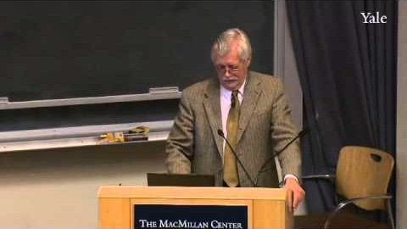
Iván Szelényi, lecture at Yale University
“Conceptual Foundations of Weber's Theory of Domination” Part of the course: “Foundations of Modern Social Thought”
Video, embedded below, and available to watch online (link in sources/resources page)

Slide 10
Sources & Resources
Jensen, Anthony K. “Neo-Kantianism,” Internet Encyclopedia of Philosophy. https://www.iep.utm.edu/neo-kant/
Kohlenbach, Margarete (2009). “Transformations of German Romanticism 1830-2000.” In The Cambridge Companion to German Romanticism. Edited by Nicholas Saul. Cambridge and New York: Cambridge UP. pp. 257-280.
“Webster’s The Protestant Ethic,” BBC In Our Times. Available here: https://www.youtube.com/watch?v=6NdrQHvN2kU
Rudel, Tom. (2016) “Classical Sociological Theory – Marx, Weber, Durkheim”. SESYNC. Available here: https://www.youtube.com/watch?v=UYTZFaNNy-w
Szelényi, Iván. “Conceptual Foundations of Weber’s Theory of Domination,” Foundations of Modern Social Theory. Yale University. Yale Open University. https://www.youtube.com/watch?v=9fryN6wKs4w

